Slide 1

Grocery Buddy
By Ecoders (Patrick, Raly, Kevin, Toni, and Carlo)

Slide 2
Agenda
What it does?
App Structure
UI Mockups/UX Flow
Task Planning

Slide 3


What Does It Do?
“Make the most of out what you have”
Plan what you buy – Grocery Lists
Make sure you use it – Fridge expiry trackers and push notifications
Notes:
Grocery Buddy helps consumers reduce food waste by allowing them to make the most of out of what they have
This is done by helping you plan what you buy using grocery lists
Making sure you use it using fridge expiry trackers and push notifications
Next Patrick is going to explain the structure of our app

Slide 4
Flow Chart
Notes:
Three Main Pages
Home -> All shopping lists created
List -> Items in Individual Lists
Fridge -> Perishable and non-perishable items in home
Relationships
List-Fridge -> Check fridge to make shopping list
Home-List -> Swap between lists
Fridge-Home -> Connects main pages
One-click navigation

Slide 5
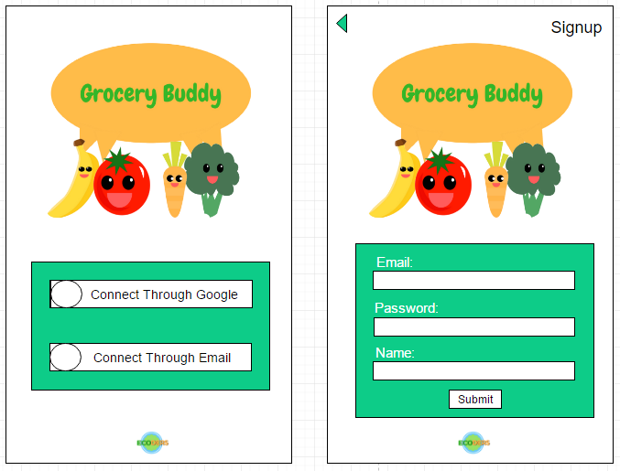
Login/Register

Slide 6
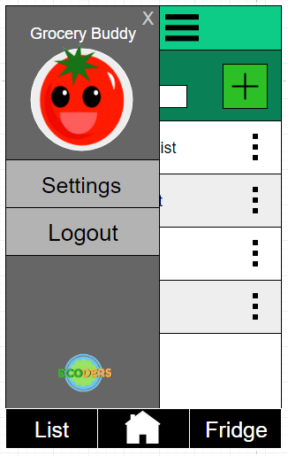
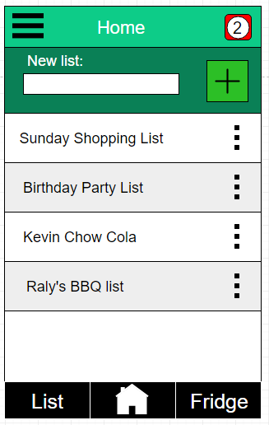
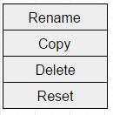
Home
Notes:
Nav Bar
Access 3 primary landing pages
Sidebar
Collapsible
Settings
List options
Select list
New list
Rename
Copy
Reset

Slide 7
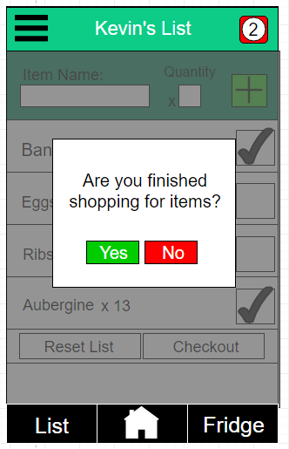
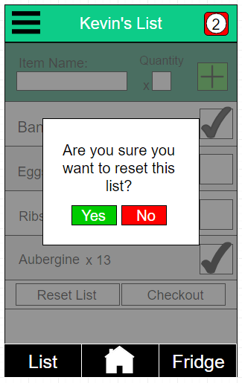
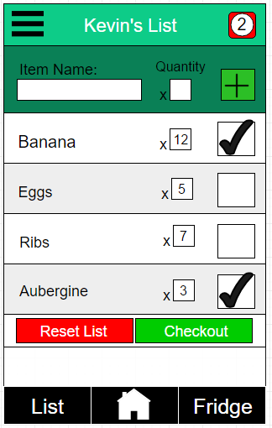
List
Notes:
Add new item
Add its name and quantity
Rename, change quantity of, and check off items
Reset list – undo check marks
Checkout items – add to fridge
Main gestures:
Double-tap to rename
Swipe left or right to delete
Hold + drag to reorder

Slide 8
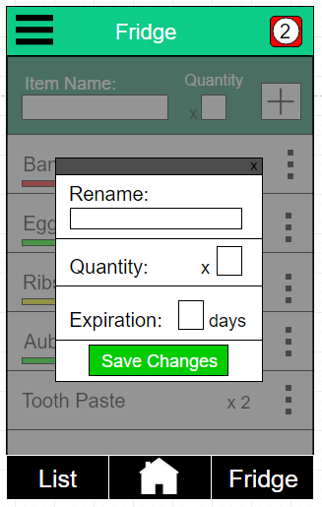
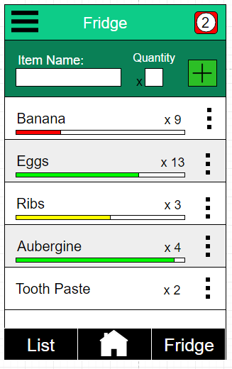
Fridge
Notes:
View all food products that you have in your fridge.
Expiration tracker will show default timers that we will set in our database, bar changes from green to yellow to red depending on how close the item is to it’s expiration date.
Red Notification Symbol at the top. The number indicates the number of almost expired food items you have in your fridge.
Enter custom items at the top by just adding it’s name and quantity.
Swipe to remove an item from the fridge
Options
Rename items – in case you have more than one in the fridge
Change quantity – of food you’ve used/eaten
Change expiration tracker manually – works especially with items that don’t have default expiration trackers

Slide 9
Task Planning
Current Iteration | 2
Assignee | Iteration | Status | ID | Depends On | Description | Importance | Estimated Time | Actual Hours | Comments
Carlo | 1 | Done | 1 |  | Make awesome buddies! | Must | a few hours | 5 | worked on during study room session, created 12 buddies
Raly | 1 | Done | 2 |  | Create ECODERS logo | Must | an hour | 1 | worked on creating templates and decided on a logo
Kevin | 1 | Done | 3 |  | Develop App wireframes | Should | a couple of hours | 2 | UI designed
Toni | 1 | Done | 4 | 5 | Edit Video Footage | Must | a couple of hours | 2 | finished 30 seconds pitch video
Whole Team | 1 | Done | 5 |  | Shoot Video Footage | Must | half a day | 1.5 | Shot several scenes at different locations for our pitch script.
Carlo | 1 | Done | 6 |  | Create Grocery Buddy logo | Must | an hour | 1 | made first draft, still finalizing
Kevin | 2 | Done | 7 |  | Create several mockups of App color scheme | Should | an hour
Kevin | 1 | Done | 8 |  | Finish and submit Project Summary | Must | an hour | 1.5 | Solidified our ideas, plans, and requirements for the project
Whole Team | 1 | Done | 9 |  | Create team charter | Must | a couple of hours | 1.5 | Established an all-encompassing team charter.
Whole Team | 1 | Done | 10 |  | Create mind-map of ideas for our app | Must | a couple of hours | 1 | Brainstormed ideas for the functions and style of our app
Patrick | 1 | Done | 11 |  | Create UI wireframes | Should | an hour
Patrick | 1 | Done | 12 |  | Record voice-over for pitch | Should | half an hour | 0.5
Carlo | 1 | Done | 13 |  | Create and assembled powerpoint | Should | an hour | 0.5
Whole Team | 1 | Done | 14 |  | Collaborated on summary page presentation | Must | a couple of hours
Toni | 1 | In Progress | 15 |  | Compile common grocery list and their expiration date | Should | a couple of hours
Whole Team | 2 | Done | 16 |  | Think of differentiating features for our app | Must | a couple of hours | 0.5
Raly | 2 | Done | 17 |  | Finished the page wireframes for app | Must | a couple of hours | 2
Whole Team | 2 | Done | 18 |  | Take a look into Fire base/Angular | Should | a couple of hours | 2
Whole Team | 2 | Done | 19 |  | Understand git flow process | Must | a couple of hours | 3
Whole Team | 2 | Done | 20 |  | Complete git repo using gitflow process | Must | a couple of hours | 2
Patrick | 2 | Not Started | 21 |  | Create AngularJS cheat sheet for core functions | Should | a couple of hours
Patrick | 2 | Done | 22 |  | Determine core concepts of using Angular with Bootstrap | Should | a couple of hours | 1
Patrick | 2 | Not Started | 23 |  | Research core concepts of using Angular with Firebase | Should | a couple of hours
Patrick | 2 | Not Started | 24 | 22 | Create cheat sheet of any changes between AngularUI and standard Bootstrap JS | Should | a couple of hours
Raly | 2 | In Progress | 25 |  | Research how to implement firebase | Should | a couple of hours
Kevin | 2 | In Progress | 26 |  | Finish Bootstrap demo | Should | a couple of hours
Kevin | 2 | Done | 27 |  | Complete UX/UI walkthrough | Must | a couple of hours | 6 | Ensured all necessary functions were applied in a thoughtful way
Kevin | 2 | Not Started | 28 |  | Research Angular to integrate with Bootstrap and Firebase | Should | a couple of hours
Kevin | 2 | Done | 29 |  | Complete several UI mockups for sprint #1 | Must | a couple of hours
Carlo | 2 | Done | 30 |  | Research Firebase functions which can be used in our app | Should | a couple of hours
Toni | 2 | Done | 31 |  | Make mockup prototype (login page, setting) | Should | an hour | 1 | made 2 sample pages with bootstrap.
Patrick | 2 | Not Started | 32 | 23 | Create presentable cheat sheet for using Angular with Firebase | Should | a couple of hours
Raly | 2 | Not Started | 33 |  | Test firebase features | Should | a couple of hours
Kevin | 2 | Done | 34 |  | Research UI elements | Should | a couple of hours
Patrick | 2 | Done | 35 |  | Prototype List App in Angular: Build Basic CSS Layout | Should | an hour | 0.5
Patrick | 2 | Done | 36 | 35 | Prototype List App in Angular: Build basic Angular setup that displays list based on array of objects | Should | an hour | 1
Patrick | 2 | Done | 37 | 36 | Prototype List App in Angular: Get each element in list to manage its own functionality, plus interact with its containing array | Should | an hour | 1
Patrick | 2 | Not Started | 38 | 37 | Prototype List App in Angular: Implement multiple lists | Should | a couple of hours
Patrick | 2 | Not Started | 39 | 36 | Prototype List App in Angular: Implement list filtering | Should | a couple of hours
Patrick | 2 | Done | 40 | 22 | Get Bootstrap test project running | Should | an hour | 1
Patrick | 2 | Done | 41 | 40 | Get Angular UI working in Bootstrap test project | Should | a couple of hours | 1.5
Patrick | 2 | Done | 42 | 41 | Get Angular UI's Sortable project working in Bootstrap test project | Should | a couple of hours | 1 | Half-way working. When sortable works, the standard UI Bootstrap stuff doesn't. Looks like I'll need to re-assemble and hand-pick all the dependencies for each.
Kevin | 2 | Done | 43 | 27 | Make changes to UI based on UX walkthrough | Must | an hour
Patrick | 2 | Done | 44 | 54 | Take knowledge from Bootstrap / Angular UI / Sortable test and implement Sortable in Prototype List App | Should | half an hour | 0.1 | Took no time at all. The last few steps came together really easily.
Kevin | 2 | Done | 45 |  | Return a selection of possible fonts for UI | Should | an hour
Kevin | 2 | In Progress | 46 |  | Practice coding UI elements using Bootstrap cheat sheet | Should | a couple of hours
Patrick | 2 | Not Started | 47 |  | Research and document possible swipe events that work with Angular / Bootstrap, then select one | Should | a couple of hours
Patrick | 2 | Not Started | 48 | 47 | Integrate swipe event into Prototype List App | Should | a couple of hours
Toni | 2 | Done | 49 |  | Research different Bootstrap themes picked 3 | Should | a few minutes |  | picked 3 themes from bootswatch.com
Carlo | 2 | Done | 50 |  | Create outline for PPT for UI presentation | Must | half an hour | 0.5 | Outline is ready, just needs content
Carlo | 2 | In Progress | 51 | 50 | Fill content for for PPT | Must | an hour
Carlo | 2 | Done | 52 |  | Set up code for pulling data from list | Could | an hour | 1 | Using lists to test if data can be accessed properly
Patrick | 2 | Done | 53 | 42 | Define dependency requirements for Angular, UI Bootstrap, UI Sortable, and determine reasonable intersections. | Must | half an hour | 0.5
Patrick | 2 | Done | 54 | 53 | Select, assemble, and import dependencies for Angular, UI Bootstrap, UI Sortable. | Should | a couple of hours | 0.5
Carlo | 2 | Done | 55 |  | Work on predictive text code | Should | an hour | 1
Patrick | 2 | Done | 56 |  | Get UI Sortable to work on mobile | Should | an hour | 1
Kevin | 2 | Done | 57 |  | Created demo header for UI prototype | Should | a couple of hours | 2
Carlo | 2 | Done | 58 |  | Research user authentication on Firebase | Should | an hour | 1 | Found out buttons and functions are available, still need to figure out how to implement
Toni | 2 | Done | 59 |  | Research AngularJS integration with Bootstrap Framework. | Must | half an hour | 0.5 | Tried out AngularJS on Bootstrap, was not successful in integration. More research needed.
Patrick | 2 | Not Started | 60 |  | Compare AngularJS vs Angular2 essentials | Must | half an hour
Patrick | 2 | Not Started | 61 | 60 | Compare Angular 1/2 compatibilities | Must | half an hour
Whole Team | 2 | In Progress | 62 |  | Plan UX Walkthrough of main pages/sections | Must | half an hour
Patrick | 2 | Not Started | 63 |  | Prioritize UI elements by number of pages, frequency of use. Try to isolate dedicated functions that are on multiple pages. | Must | an hour
Kevin | 2 | Done | 64 |  | Coded prototype sticky footer for application | Should | an hour
Kevin | 2 | Done | 65 |  | Coded prototype list elements | Should | a couple of hours | 2
Kevin | 2 | Done | 66 |  | Coded prototype modal/pop-up list elements | Should | an hour | 1
Carlo | 2 | Done | 67 |  | Create flow chart for UI | Must | half an hour | 0.5
Toni | 2 | Done | 68 |  | Lookup tutorials for AngularJS and Bootstrap integration on YouTube | Should | an hour | 0.1 | Found tutorial course on stacksocial that I purchased years ago on AngularJS.
Toni | 2 | In Progress | 69 |  | Fix Prototype into what the team envisioned | Should | an hour
Whole Team | 2 | Done | 70 |  | prototype for base page | Should | a few minutes | 0.1
Whole Team | 2 | In Progress | 71 |  | prototype for login page | Must | a few minutes | 0.1 | necessary for UI presentation
Whole Team | 2 | In Progress | 72 |  | prototype for register page | Must | a few minutes | 0.1 | necessary for UI presentation
Whole Team | 2 | In Progress | 73 |  | prototype for user's lists page | Must | a few minutes | 0.1 | necessary for UI presentation
Whole Team | 2 | In Progress | 74 |  | prototype for foldout menu | Must | a few minutes | 0.1 | necessary for UI presentation
Whole Team | 2 | In Progress | 75 |  | prototype for settings page | Must | a few minutes | 0.1 | necessary for UI presentation
Whole Team | 2 | In Progress | 76 |  | prototype for fridge page | Must | a few minutes | 0.1 | necessary for UI presentation
Whole Team | 2 | In Progress | 77 |  | prototype for list page | Must | a few minutes | 0.1 | necessary for UI presentation
Whole Team | 2 | In Progress | 78 |  | prototype for reset dialogue box | Must | a few minutes | 0.1 | necessary for UI presentation
Whole Team | 2 | In Progress | 79 |  | prototype for checkout dialogue box | Must | a few minutes | 0.1 | necessary for UI presentation
Whole Team | 2 | Done | 80 |  | prototype for items greyed out | Must | a few minutes | 0.1 | No longer necessary, deleted from draw.io
Whole Team | 2 | In Progress | 81 |  | plan UI presentation | Should | a couple of hours
Toni | 2 | Done | 82 |  | Start and Finish Intro Section of AngularJS: From Zero to Hero | Should | a few minutes | 0.1 | understand the basic concepts of AngularJS which involves date binding!
Toni | 2 | In Progress | 83 |  | Start and Finish Controllers & Modules in Intro Section of AngularJS: From Zero to Hero | Should | a few minutes | 0.1 | understand that AngularJS deals with
Notes:
Scrum meetings before every lab
Determine major tasks
Break up tasks into smaller goals

Slide 10




Conclusion
THANKS!

